Slide 1
DTOs and Domain Models
Dtos are objects that are used to transfer data between different layers of components of an application these typically contain a subset of the properties in domain model
We don’t send domain model back to the client because of security reasons
Advantages of DTOs- separation of concerns, security, performance , versioning

Slide 2
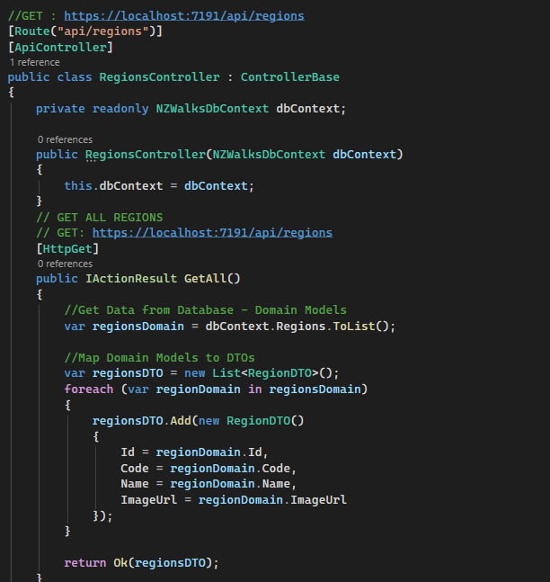
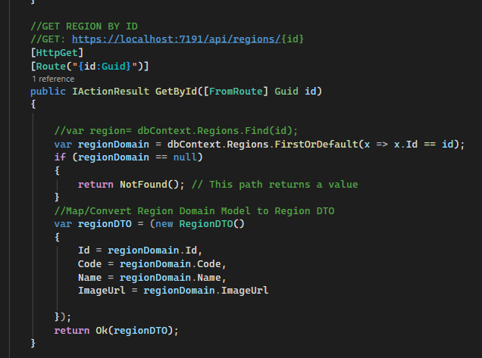
CRUD Operations on database
1. GET
Get all the regions
Get a particular region by an id

Slide 3
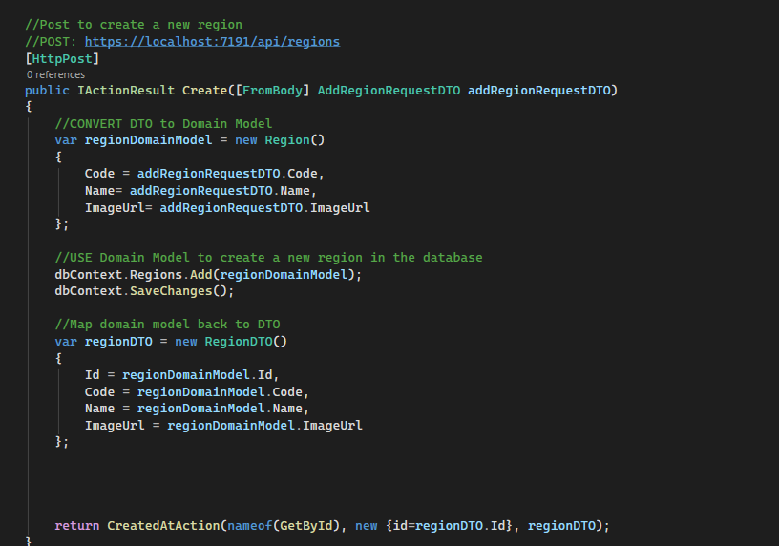
2. POST

Slide 4
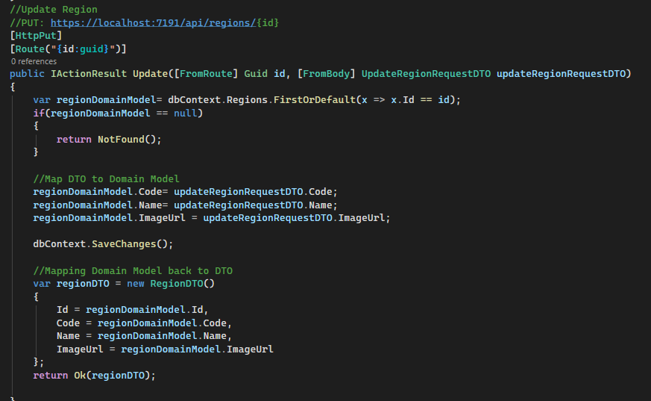
3. UPDATE(PUT)

Slide 5
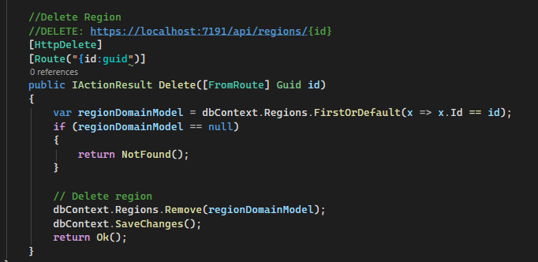
4. DELETE

